Slide 1
EMPLOYEE PERFORMANCE ANALYSIS USING EXCEL
STUDENT NAME : SHALINI. K
ROLL NO : 312209936
DEPARTMENT : B.com bank management
COLLEGE : valliammal college for women.

Slide 2
PROJECT TITLE
EMPLOYEE PERFORMANCE ANALYSIS USING EXCEL

Slide 3
AGENDA
Problem Statement
Project Overview
End Users
Our Solution Proposition
Dataset Description
Modelling Approach
Results and Discussion
Conclusion

Slide 4
PROBLEM STATEMENT
Utilize Excel to efficiently analyze employee data by leveraging Function such as PIVOT TABLES, and conditional formatting.
The enables the identification of key trends, such as current Employees data.
Decision-making processes by visualization this data through PIE CHART.

Slide 5
PROJECT OVERVIEW
This project focuses on analysing employee data to identify trends
And insights that can drive better decision.
Excel will be used to clean, organize, and visualise key metrics such as
Employee demographics, performance, and retention rates.
The analysis will highlights areas of improvement in workforce management
Helping to optimize resource allocation.
Outcomes will include detailed reports and dashboard for management
The finding aim to support strategic planning.

Slide 6
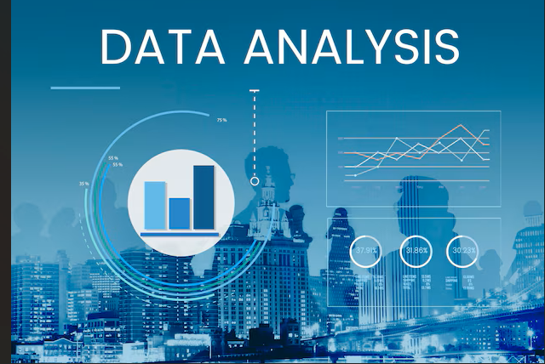
WHO ARE THE END USERS ?
The end users of the employee data employee data analysis are HR
Managers team leads and senior management

Slide 7

OUR SOLUTION AND ITS VALUE PROPOSITION
Conditional formatting – highlights missing cells
Filter – helps to remove the empty cells
Formulas – helps to identify the performance of employees
Pivot table – helps summarize
Pie chart – shows the data

Slide 8
Dataset Description
1. Employee ID
2. First name
3. Last name
4. Business unit
5. Employee classification type
6. Employee type
7. Gender
8. Performance score
9. Current employee rate
10. Performance level

Slide 9

THE "WOW" IN OUR SOLUTION
Performance level
=IFS(Z8>=5,”VERYHIGH”,Z8>=4,”HIGH”,
Z8>=3,”MED”,TRUE,”LOW”)

Slide 10
MODELLING
DATA COLLECTION
*Identification
*Gathering
*Preparation
DATA CLEANING
*Standardisation duration
*Correction
*Validation
SUMMARY
Data analysis involves examining, transforming, Modelling data
To Extract insights , identify patterns, and support decisions-making.

Slide 11
RESULT

Slide 12
conclusion
* IN CONCLUSION, the employee data analysis conducted using Excel
Provided valuable insights into workforce trends enabling more Informed decision-making.
The use of Excel allowed efficient data organization, visualization
and reporting, ultimately helping to enhance HR strategies, improve
and employee satisfaction and optimize overall organizational performance.

